Slide 1
Case studies illustrating some typical scenarios,
in which the Simple pClamp Analyzer can be used
Benefits of the tools:
Suitable for any type of voltage-dependent ion channel currents (Na⁺, Ca²⁺, K⁺)
Can handle data acquired using both voltage steps and voltage ramps
Ensures reliable, human error free data analysis
Produces publication quality graphs
Considerably faster compared to manual data analysis
Sample files provided:
1. INa_act.dat
2. INa_inact.dat
3. ICa.abf
4. IKdr.dat
5. IA.dat
6. Icat.abf
Sample files are saved in Apps folder: \\Simple pCLAMP Analyzer\Samples
NB brief step-by-step instructions on how to reproduce the following graphs are contained in slide notes

Slide 2
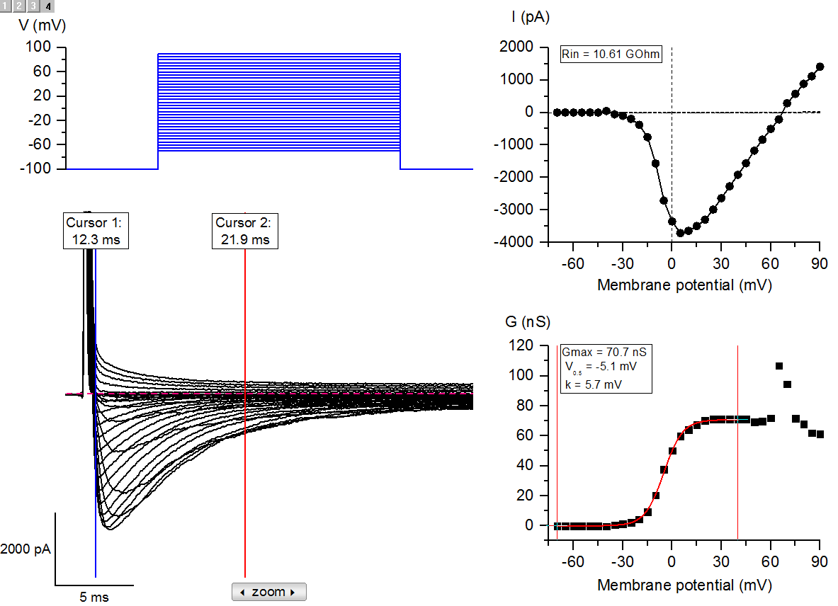
Activation of voltage-gated sodium channels
Notes:
Import sample file: INa_act.dat
Confirm Offset value = -57 (this file was recorded with an older version of Clampex, no offset correction is required in v.8 and above)
Zoom in data (by positioning cursors 1 & 2 around the required region and pressing the zoom button) and position cursors 1 and 2 as shown in layer 2
Press Voltage steps I-V
Choose Epoch 2, Absolute peak All episodes
Press Leak correction – enter 6 (first 6 data points from -70 to -45 mV will be used to estimate leak, as shown by the dotted line)
Press Voltage steps G-V
Erev=67
Click on data points and position the data selectors as shown in layer 4
The selected data points are fitted by Boltzmann equation with the activation parameters indicated

Slide 3
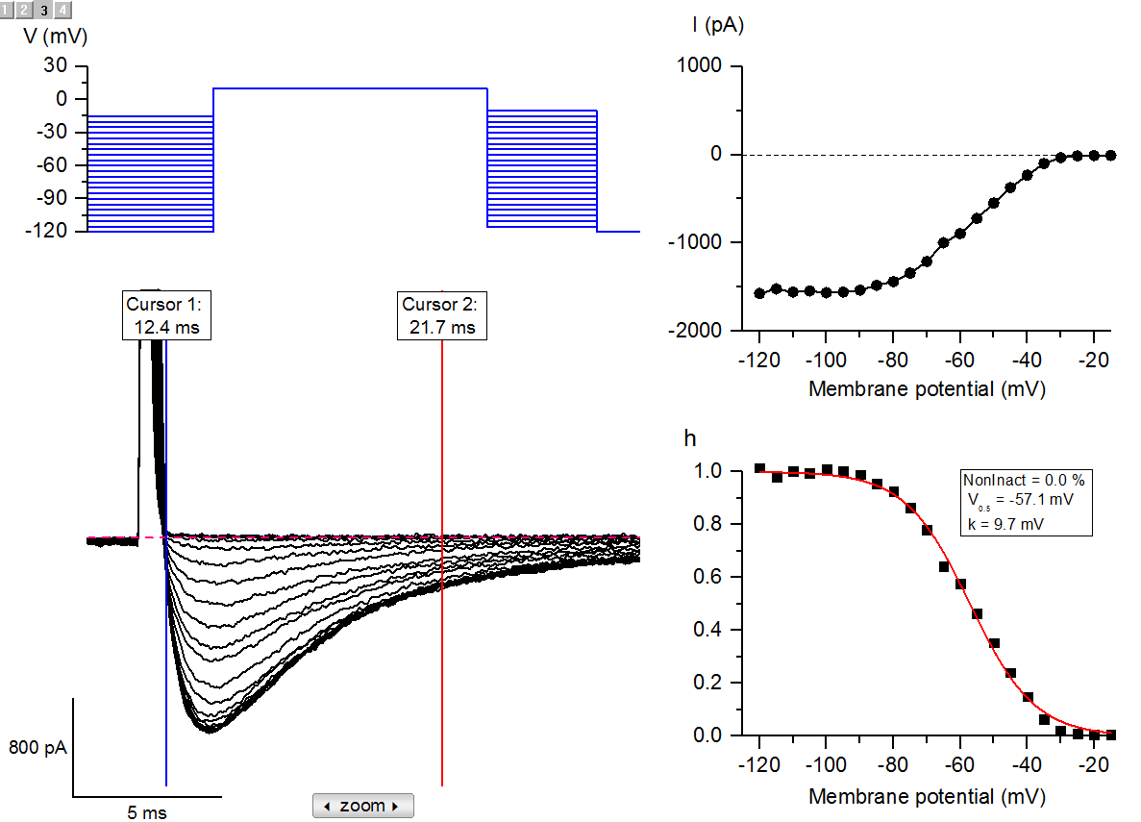
Inactivation of voltage-gated sodium channels
Notes:
Import sample file: INa_inact.dat
Confirm Offset value = -59 (this file was recorded with an older version of Clampex, no offset correction is required in v.8 and above)
Zoom in data and position cursors 1 and 2 as shown in layer 2
Press Voltage steps I-V
Choose Epoch 1, Minimum All episodes
Press Inactivation
N plateau points=5 (first 5 data points from -120 to -100 mV will be used to calculate mean maximal Na current, normalised as 1.0 in the next step)
Click on data points and position the data selectors as shown in layer 4
Normalised data points are fitted by Boltzmann equation with the inactivation parameters indicated

Slide 4
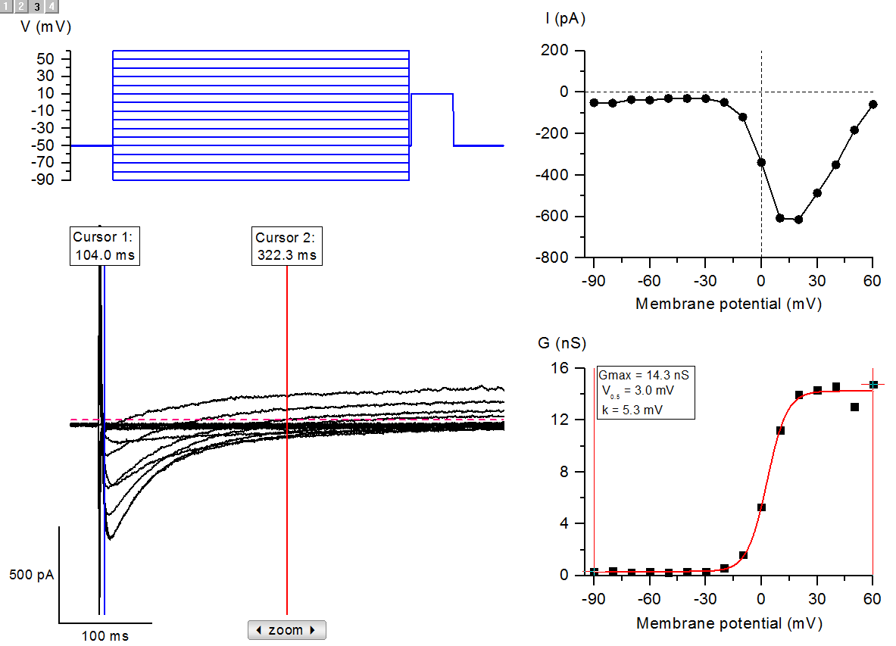
Activation of voltage-gated calcium channels
Notes:
Import sample file: ICa.abf
Zoom in data and position cursors 1 and 2 as shown in layer 2
Press Voltage steps I-V
Choose Epoch 2, Min All episodes
Press Voltage steps G-V
Erev=64
Click on G-V data points and position the data selectors as shown in layer 4
The selected data points are fitted by Boltzmann equation with the activation parameters indicated

Slide 5
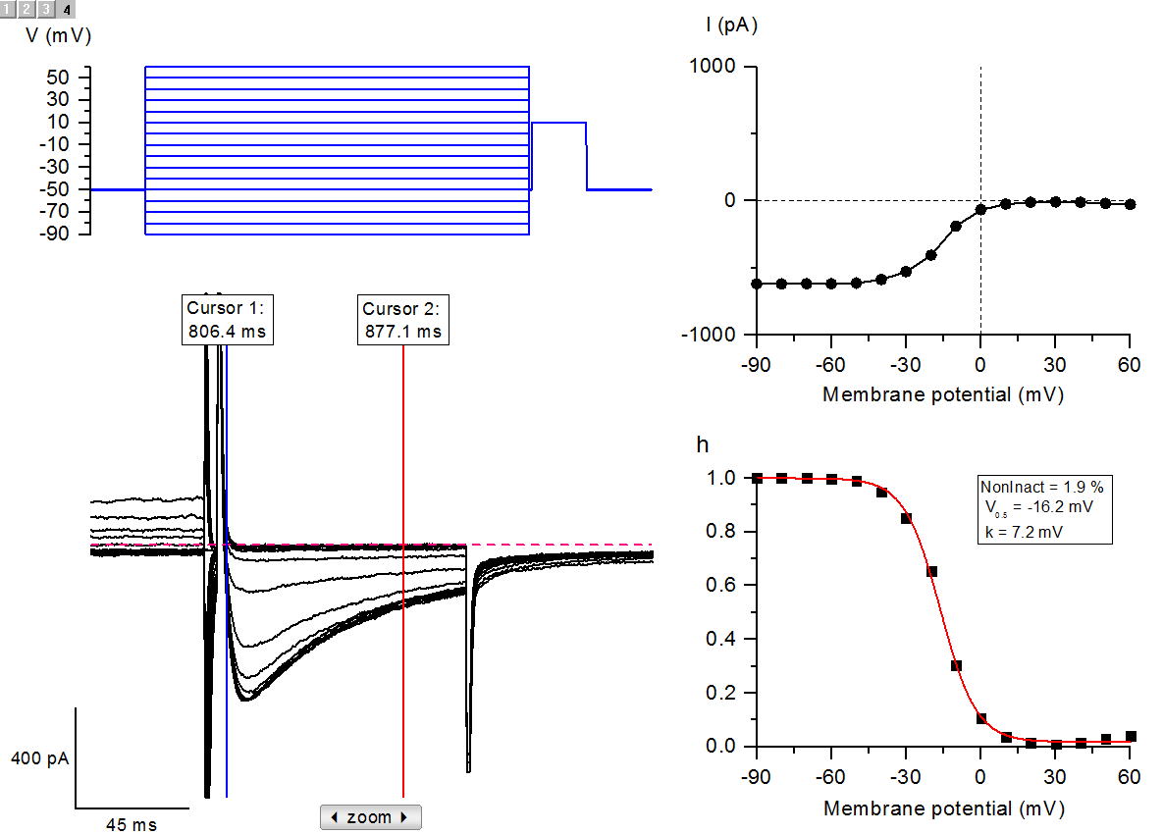
Inactivation of voltage-gated calcium channels
Notes:
Import sample file: ICa.abf
Zoom in data and position cursors 1 and 2 as shown in layer 2
Press Voltage steps I-V
Choose Epoch 2, Min All episodes
Press Inactivation
N plateau points=4 (first 4 data points from -90 to -60 mV will be used to calculate mean maximal Ca current, normalised as 1.0 in the next step)
Normalised data points are fitted by Boltzmann equation with the inactivation parameters indicated

Slide 6
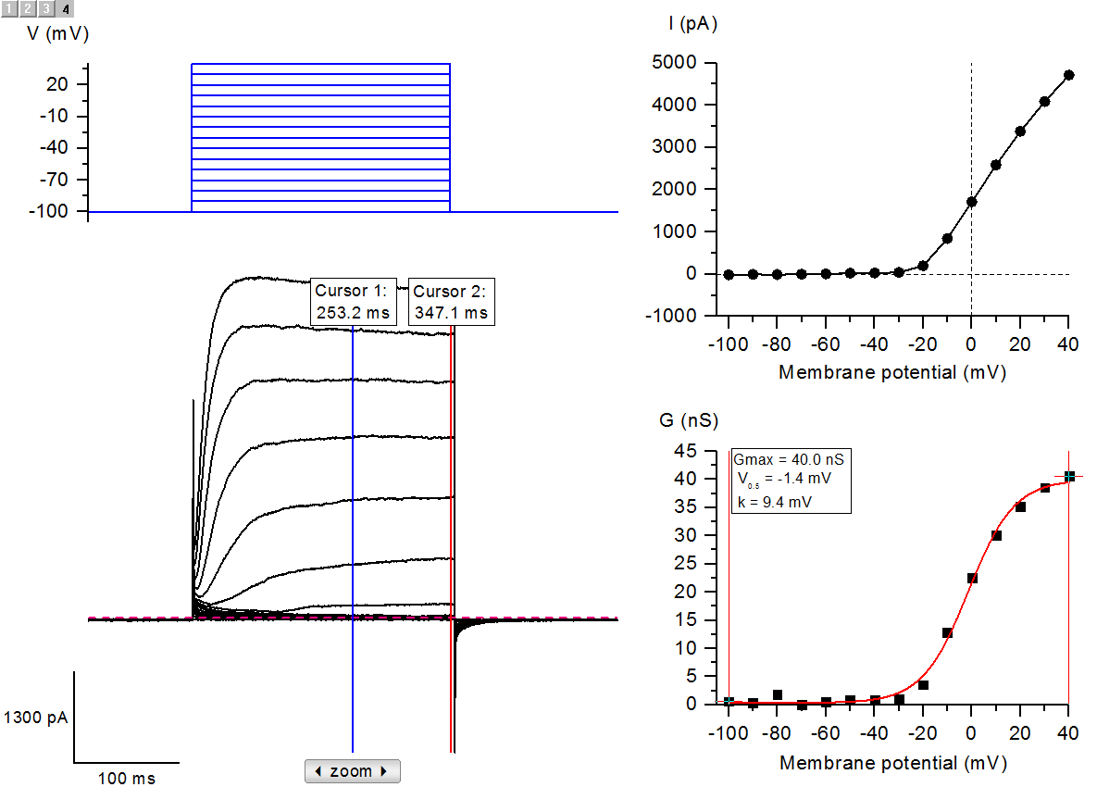
Activation of voltage-gated potassium channels
(delayed rectifier Ik,dr)
Notes:
Import sample file: IKdr.dat
Position cursors 1 and 2 as shown in layer 2, e.g. selecting the region of plateau currents
Press Voltage steps I-V
Choose Epoch 2, Max All episodes
Press Voltage steps G-V
E=-76 (this is the calculated Nernst potential for K⁺ ions according to ion conditions used in this experiment, as automatic Erev determination in this case is not possible since currents around Erev are very small)
Click on the G-V data points and position the data selectors as shown in layer 4
The selected data points are fitted by Boltzmann equation with the activation parameters indicated

Slide 7
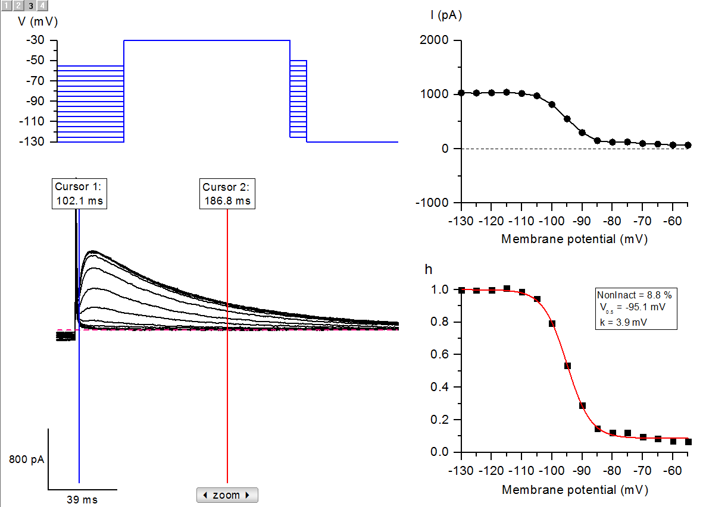
Inactivation of A-type potassium current (I_{A})
Notes:
Import sample file: IA.dat
Zoom in data and position cursors 1 and 2 as shown in layer 2
Press Voltage steps I-V
Choose Epoch 1, Max All episodes
Press Inactivation
N plateau points=4 (first 4 data points from -130 to -115 mV will be used to calculate mean maximal IA current, normalised as 1.0 in the next step)
The normalised data points are fitted by Boltzmann equation with the inactivation parameters indicated

Slide 8
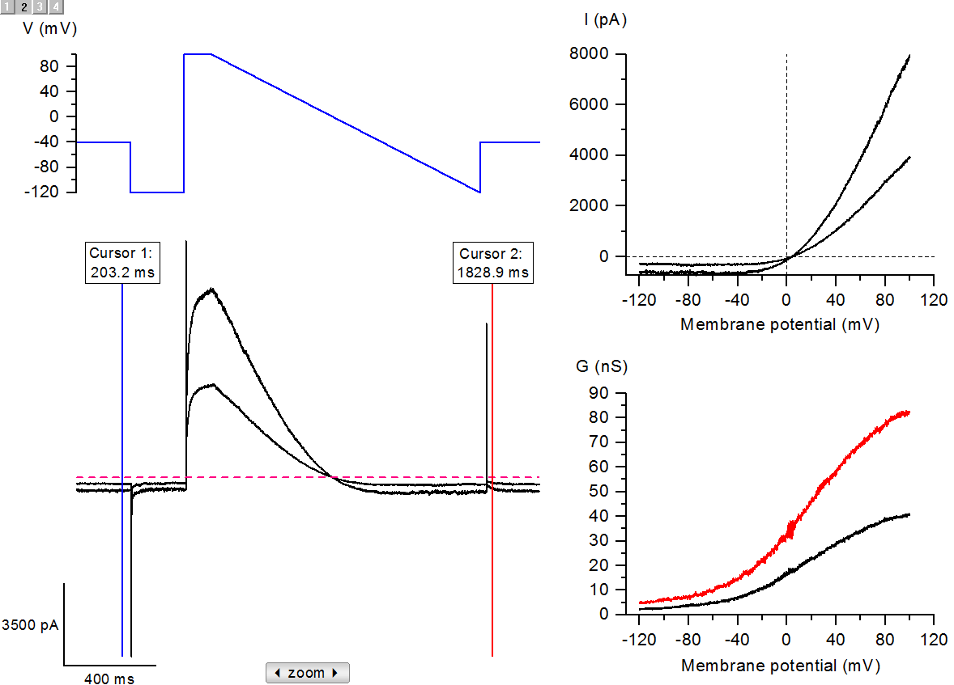
Cation current ramp I-V and G-V curves:
extracting data from multiple traces
Notes:
Import sample file: Icat.abf
Press Voltage ramp I-V
Press Voltage ramp G-V
Perform Boltzmann fit? Yes
Fit with shared slope? Yes
Fitting parameters (Gmax, V_{1/2} and slope) are saved in FitParam workbook

